Slide 1


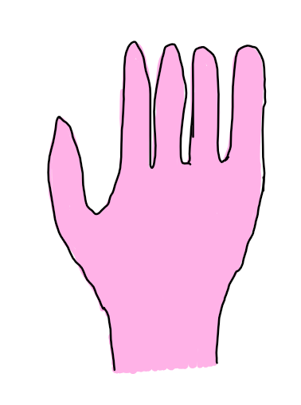
Client1: Beedicehand
Client0 (You): Honeyfourfinger
Client2: Stingdicehand
Client 0 (You): Beefourhand
*Client 0 guessed close…*
Client 1: Beefourfingers
Client 0 (You): Beforehand
*Client 0 guessed correctly!*
Time Left
0
Minute(s)
36
Second(s)
Type Guesses Here…

